Slide 1
Quantum Computing Architectures (EE274) Lecture 4
Hiu-Yung Wong
feb. 4, 2025
hiuyung.wong@sjsu.edu, Office: ENG363
http://www.sjsu.edu/people/hiuyung.wong/index.html

Slide 2
Outline
Linear Algebra

Slide 3








What did we learn in the last lecture?
Orthonormal Basis Normalized Vector
$$|\left.ψ\right\rangle =\left(\begin{matrix}\begin{matrix}a_{0} \\ a_{1}\end{matrix} \\ \begin{matrix}⋮ \\ a_{n}\end{matrix}\end{matrix}\right)$$
$\left\langle b_{i} | b_{j}\right\rangle =0$ if $i≠j$
$$\left\langle ψ | ψ\right\rangle =a_{0}^{∗}a_{0}+a_{1}^{∗}a_{1}+…+a_{n}^{∗}a_{n}=1$$
$\left\langle b_{i} | b_{j}\right\rangle =1$ if $i=j$
Change of Basis Example
$$|\left.0\right\rangle =\frac{1}{\sqrt{2}}(\left.|+\right\rangle +\left.|−\right\rangle )$$
$$|\left.1\right\rangle =\frac{1}{\sqrt{2}}(\left.|+\right\rangle −\left.|−\right\rangle )$$
$$|\left.ψ\right\rangle =\left.a|0\right\rangle +\left.b|1\right\rangle$$
$$|\left.ψ\right\rangle =\frac{1}{\sqrt{2}}((a+b)\left.|+\right\rangle +\left.(a−b)|−\right\rangle )$$

Slide 4








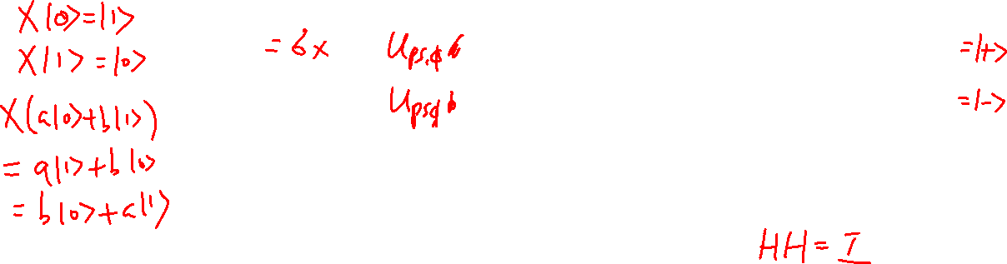

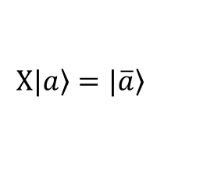

What did we learn in the last lecture?
Quantum gates are reversible
Various type of quantum gates
Hadamard (H) Gate
No classical counterpart
NOT/ X Gate
1-bit Phase Shift Gate
$$H|\left.0\right\rangle =\frac{1}{\sqrt{2}}(\left.|0\right\rangle +\left.|1\right\rangle )$$
$$X=\left(\begin{matrix}0 & 1 \\ 1 & 0\end{matrix}\right)$$
$$X=\left(\begin{matrix}1 & 0 \\ 0 & e^{iφ}\end{matrix}\right)$$
$$H|\left.1\right\rangle =\frac{1}{\sqrt{2}}(\left.|0\right\rangle −\left.|1\right\rangle )$$
$$X|\left.a\right\rangle =\left.|\overline{a}\right\rangle$$
$$X(φ=π)=Z$$
$$X(φ=π/2)=S$$
$$H=\frac{1}{\sqrt{2}}\left(\begin{matrix}1 & 1 \\ 1 & −1\end{matrix}\right)$$
$$X(φ=π/4)=T$$
$$H=H^{−1}$$

Slide 5
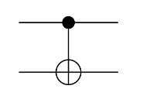


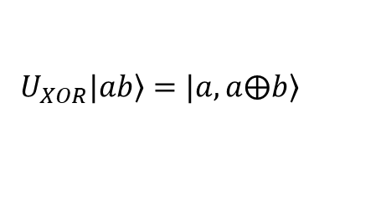
What did we learn in the last lecture? (we will learn in this class)
Tensor Product
$$\left(\begin{matrix}a_{11} & ⋯ & a_{1n} \\ ⋮ & & ⋮ \\ a_{n1} & ⋯ & a_{nn}\end{matrix}\right)⊗\left(\begin{matrix}b_{11} & ⋯ & b_{1n} \\ ⋮ & & ⋮ \\ b_{n1} & ⋯ & b_{nn}\end{matrix}\right)$$
$$=\left(\begin{matrix}a_{11}\left(\begin{matrix}b_{11} & ⋯ & b_{1n} \\ ⋮ & & ⋮ \\ b_{n1} & ⋯ & b_{nn}\end{matrix}\right) & ⋯ & a_{1n}\left(\begin{matrix}b_{11} & ⋯ & b_{1n} \\ ⋮ & & ⋮ \\ b_{n1} & ⋯ & b_{nn}\end{matrix}\right) \\ ⋮ & & ⋮ \\ a_{n1}\left(\begin{matrix}b_{11} & ⋯ & b_{1n} \\ ⋮ & & ⋮ \\ b_{n1} & ⋯ & b_{nn}\end{matrix}\right) & ⋯ & a_{nn}\left(\begin{matrix}b_{11} & ⋯ & b_{1n} \\ ⋮ & & ⋮ \\ b_{n1} & ⋯ & b_{nn}\end{matrix}\right)\end{matrix}\right)$$
$$=\left(\begin{matrix}a_{11}b_{11} & ⋯ & a_{1n}b_{1n} \\ ⋮ & & ⋮ \\ a_{n1}b_{n1} & ⋯ & a_{nn}b_{nn}\end{matrix}\right)$$
XOR/ CNOT Gate
$$U_{XOR}=\left(\begin{matrix}\begin{matrix}1 & 0 \\ 0 & 1\end{matrix} & \begin{matrix}0 & 0 \\ 0 & 0\end{matrix} \\ \begin{matrix}0 & 0 \\ 0 & 0\end{matrix} & \begin{matrix}0 & 1 \\ 1 & 0\end{matrix}\end{matrix}\right)$$
$$U_{XOR}|\left.ab\right\rangle =\left.|a,a⨁b\right\rangle$$

Slide 6
Multiple Qubits
Chapter 2 of “Quantum Computing Architecture and Hardware for Engineers: Step by Step”
Introduction to Quantum Computing From a Layperson to a Programmer in 30 Steps – YouTube
https://www.youtube.com/playlist?list=PLnK6MrIqGXsJfcBdppW3CKJ858zR8P4eP

Slide 7
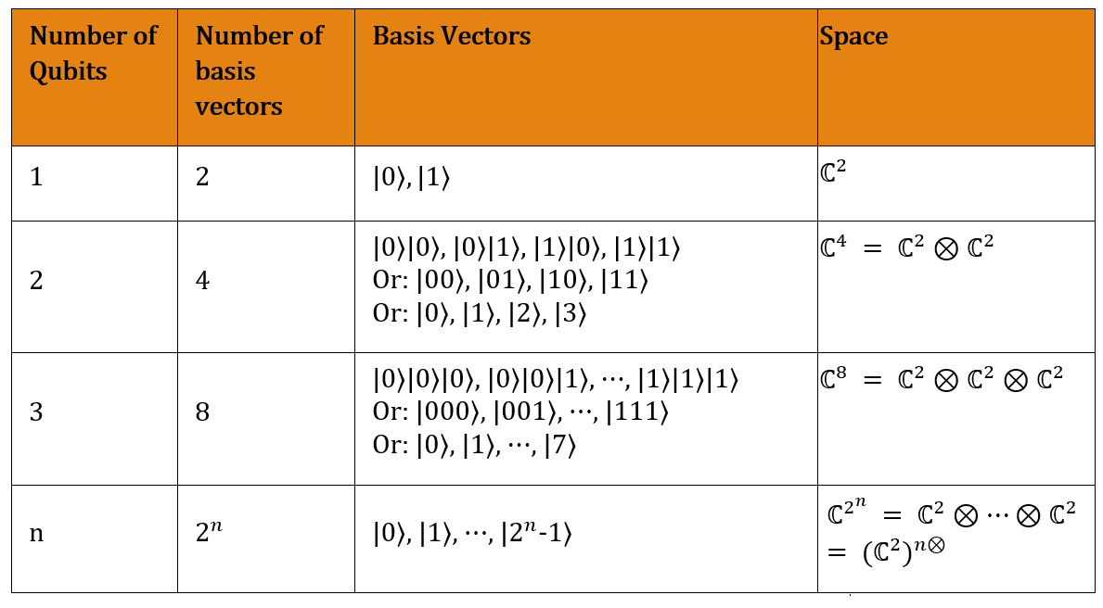

Multiple Qubits
Learning outcomes: We use tensor product to construct a bigger space from smaller spaces

Slide 8
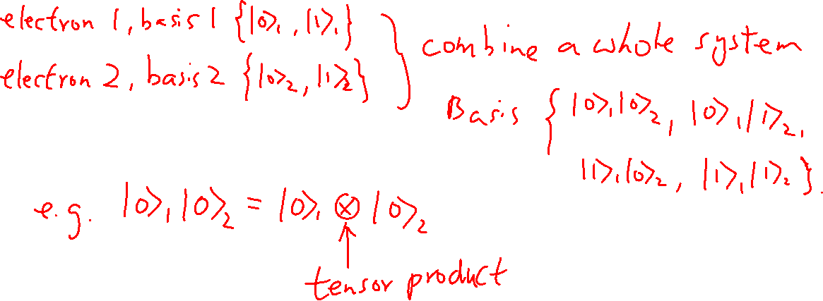
Expansion of Basis
Learning outcomes: Need to follow the rules closely. The order of the qubit cannot be changed during the operation.

Slide 9
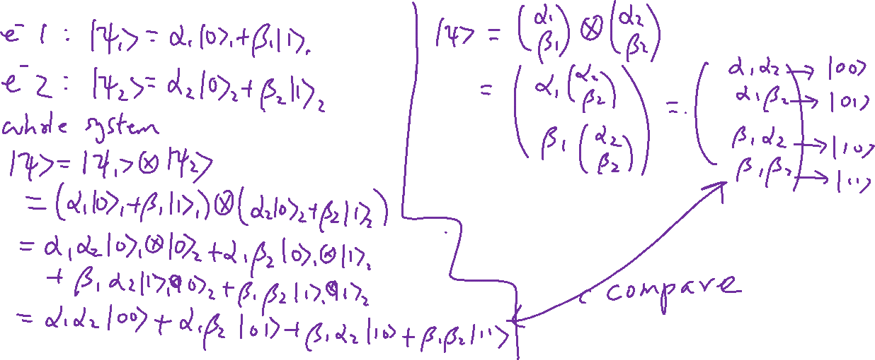
Tensor Products of Vectors
Learning outcomes: Need to follow the rule closely. The order of the qubit cannot be changed during the operation.

Slide 10
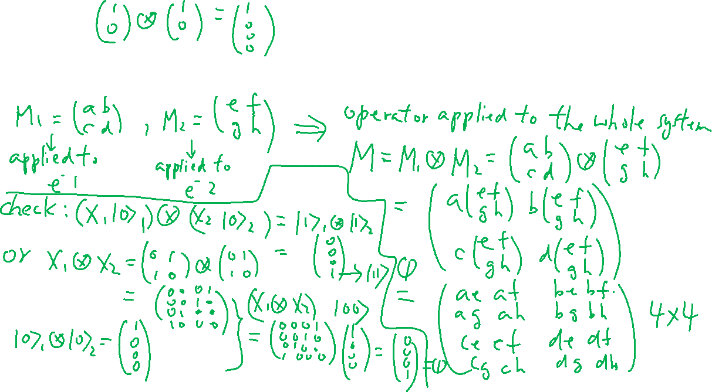
Tensor Product of Operators
Learning outcomes: Need to follow the rule closely. The order of the qubit cannot be changed during the operation.

Slide 11
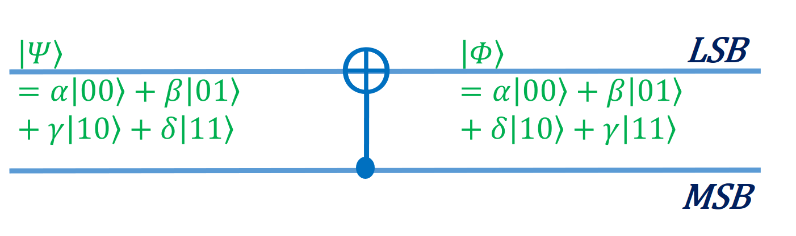

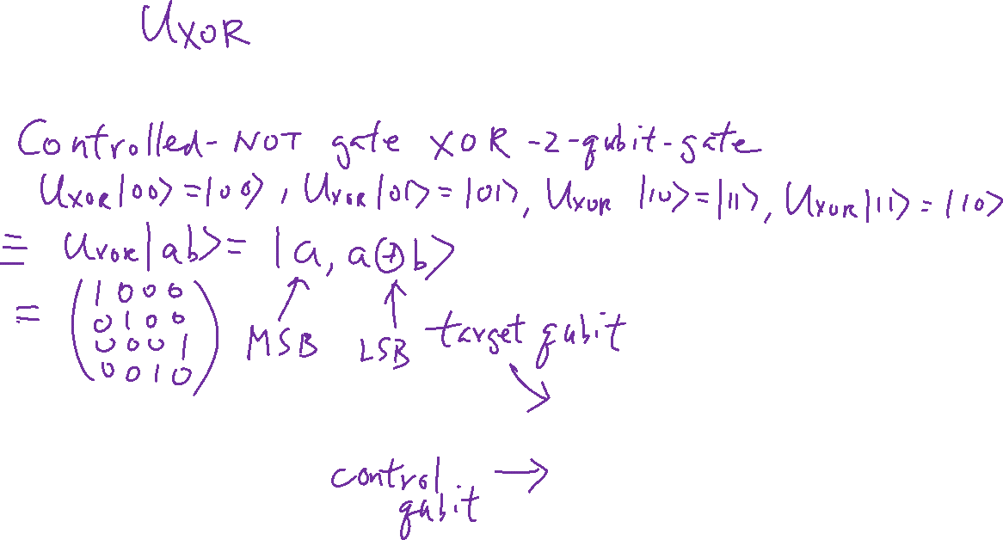
CNOT Gate and Entanglement
Learning outcomes: CNOT gate is a way to create entanglement
Recall: Universal Sets of Gate:

Slide 12
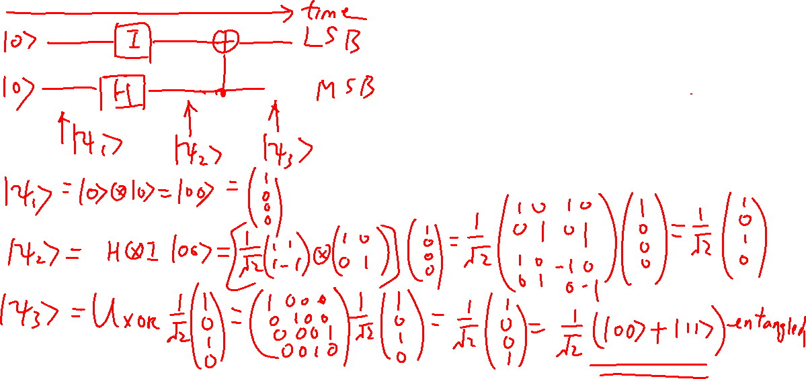
Create Entanglement using CNOT Gate
Learning outcomes: Every quantum circuit starts with the ground state. We need to learn how to initialize a state later.

Slide 13
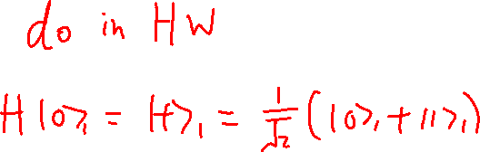
Create Entanglement using CNOT Gate-2 (“bra-ket” method instead of matrix method)

Slide 14

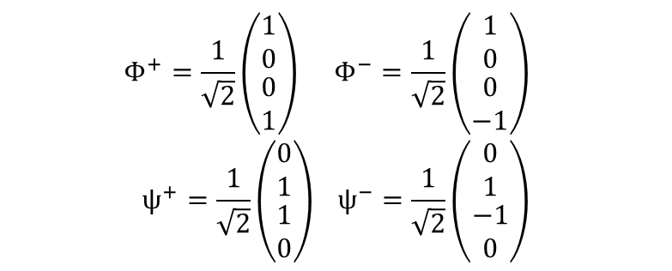
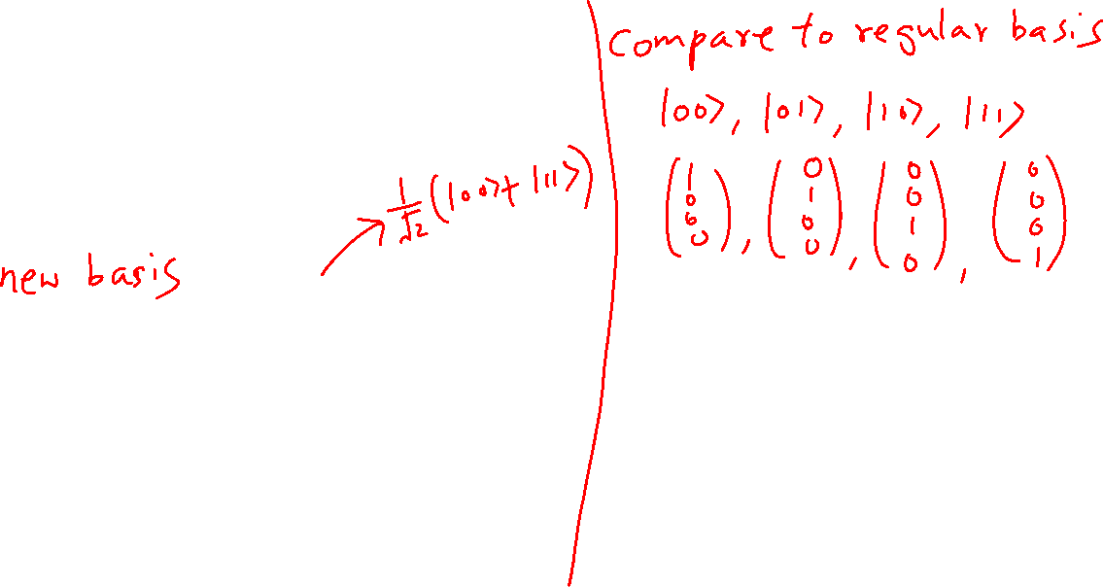
Entanglement and Bell States
Learning outcomes: Recall: Superposition and Entanglement are what make quantum computing great!
$$|\left.ψ\right\rangle ≠|\left.ψ_{1}\right\rangle ⊗|\left.ψ_{2}\right\rangle$$
Bell States
$$Φ^{+}=\frac{1}{\sqrt{2}}\left(\begin{matrix}\begin{matrix}1 \\ 0\end{matrix} \\ \begin{matrix}0 \\ 1\end{matrix}\end{matrix}\right) Φ^{−}=\frac{1}{\sqrt{2}}\left(\begin{matrix}\begin{matrix}1 \\ 0\end{matrix} \\ \begin{matrix}0 \\ −1\end{matrix}\end{matrix}\right)$$
$$ψ^{+}=\frac{1}{\sqrt{2}}\left(\begin{matrix}\begin{matrix}0 \\ 1\end{matrix} \\ \begin{matrix}1 \\ 0\end{matrix}\end{matrix}\right) ψ^{−}=\frac{1}{\sqrt{2}}\left(\begin{matrix}\begin{matrix}0 \\ 1\end{matrix} \\ \begin{matrix}−1 \\ 0\end{matrix}\end{matrix}\right)$$

Slide 15
More about Matrices
Chapter 3 of “Quantum Computing Architecture and Hardware for Engineers: Step by Step”

Slide 16
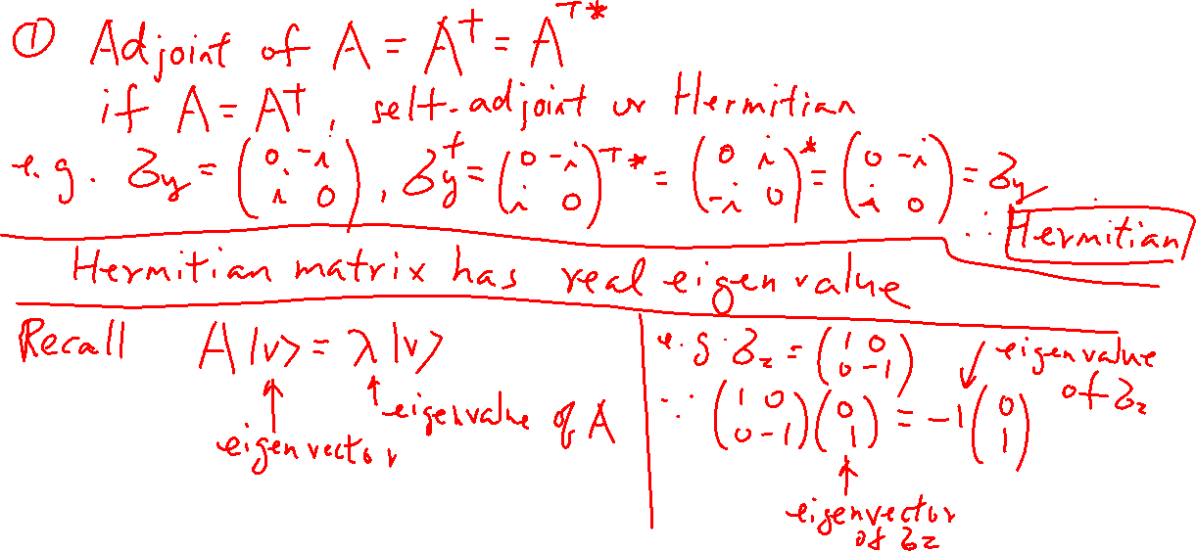
Hermitian Matrix, Eigenvalue, Eigenvectors
Learning outcomes: All observables are associated with a Hermitian Matrix. Hermitian matrix has real eigenvalues.

Slide 17
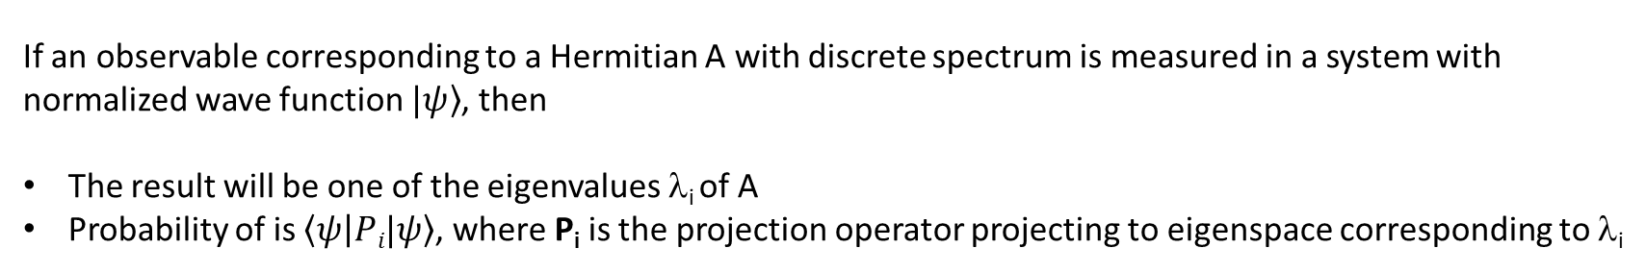
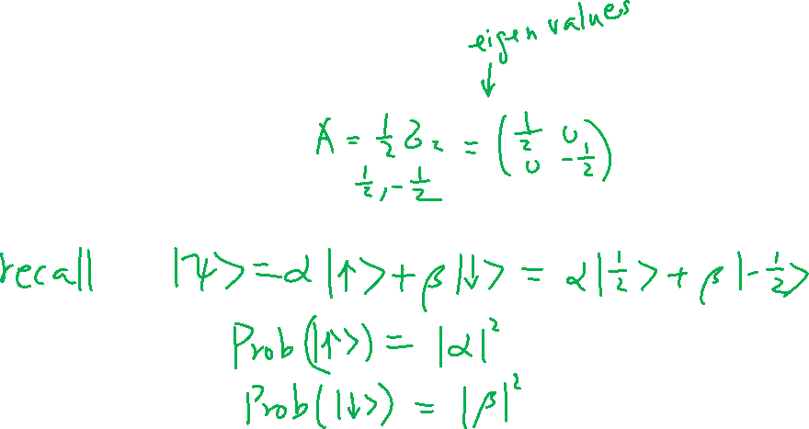
Hermitian Matrix, Measurement, and Projection Operator
Learning outcomes: All observables are associated with a Hermitian Matrix.
If an observable corresponding to a Hermitian A with discrete spectrum is measured in a system with normalized wave function $|\left.ψ\right\rangle$, then
The result will be one of the eigenvalues λ_{i} of A
Probability of is $\left\langle ψ | Pi|ψ\right\rangle$, where P_{i} is the projection operator projecting to eigenspace corresponding to λ_{i}

Slide 18
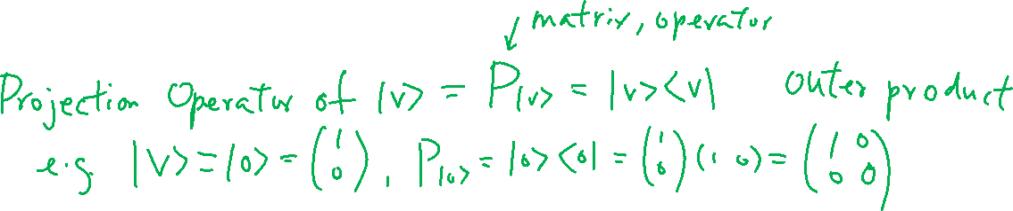
Projection Operator and Measurement Probability

